Slide 1
Errors of Martial Arts & Oriental Medicine
Exposing the Lies of the Garden

Slide 2
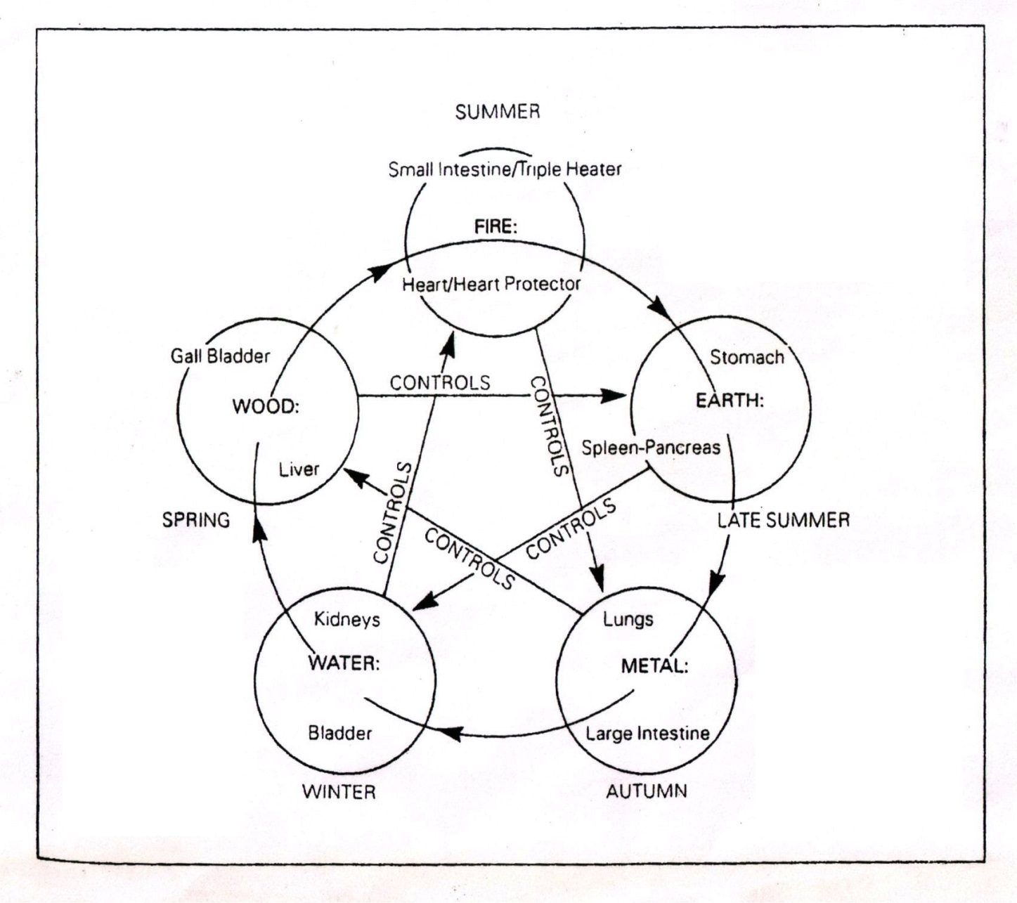
5 Element Theory

Slide 3
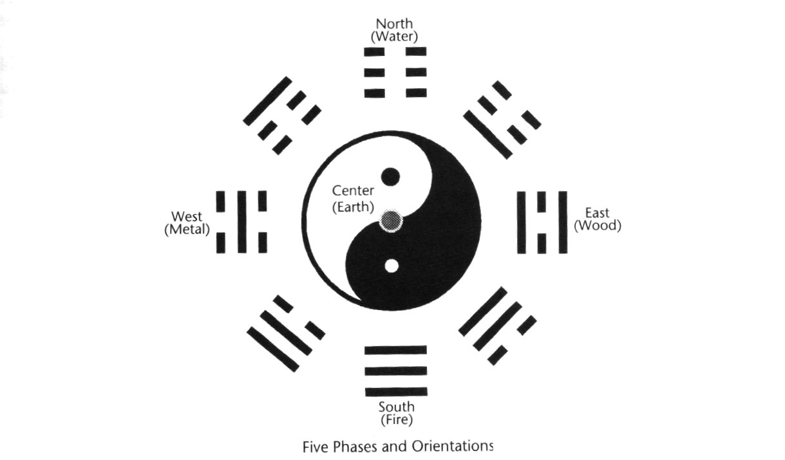
Yin | Yang

Slide 4
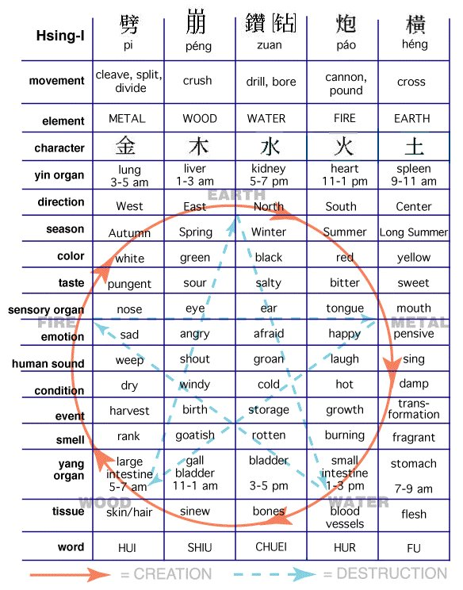
Hsing-I – Advanced 5 Element

Slide 5
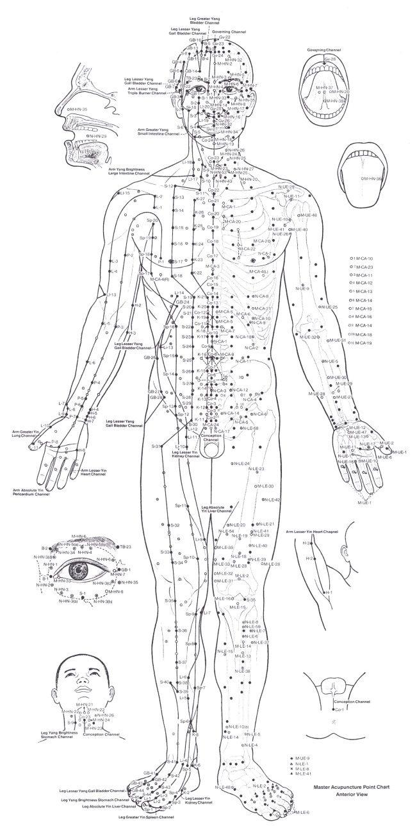
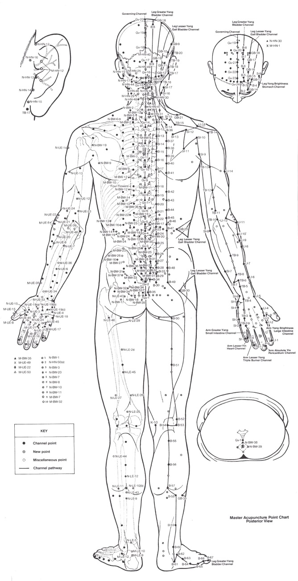
Meridians & Pressure Points

Slide 6
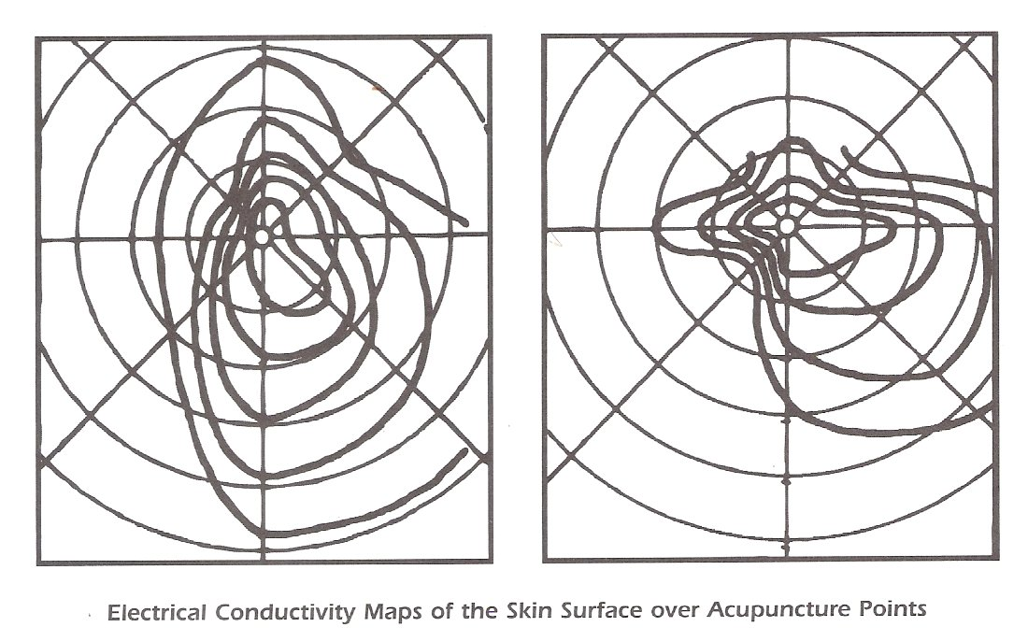
Kyusho Point Conductivity

Slide 7
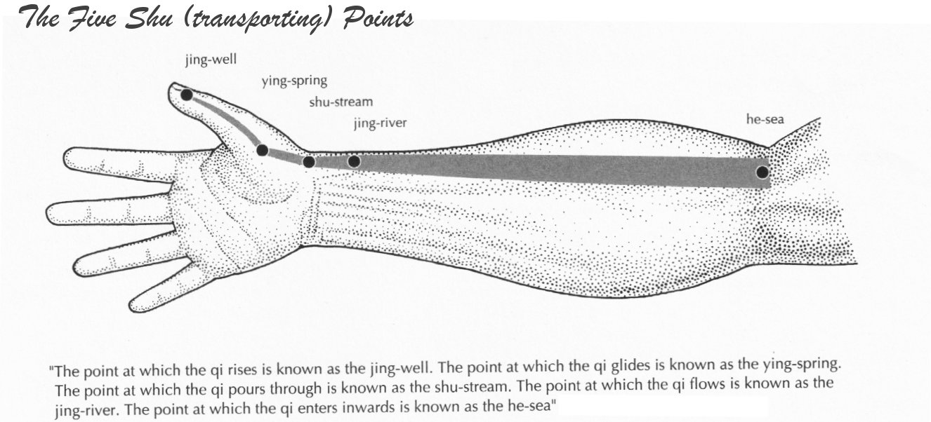
5 Shu Points

Slide 8
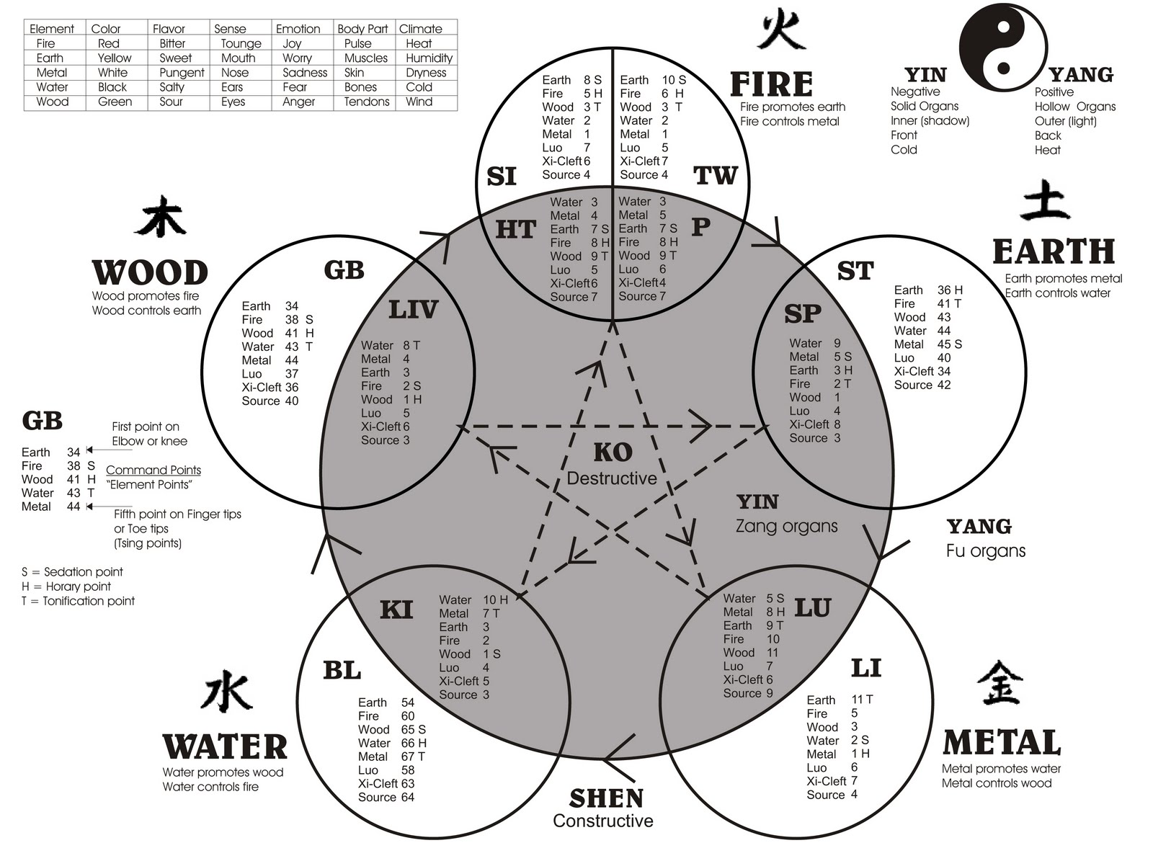
Theories Combined

Slide 9
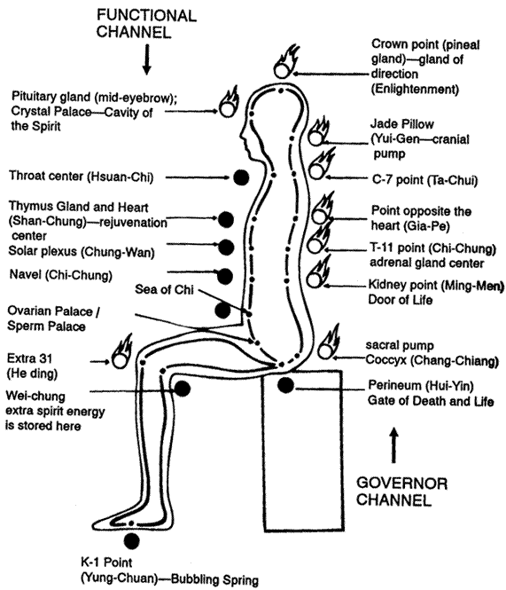
Microcosmic Orbit

Slide 10
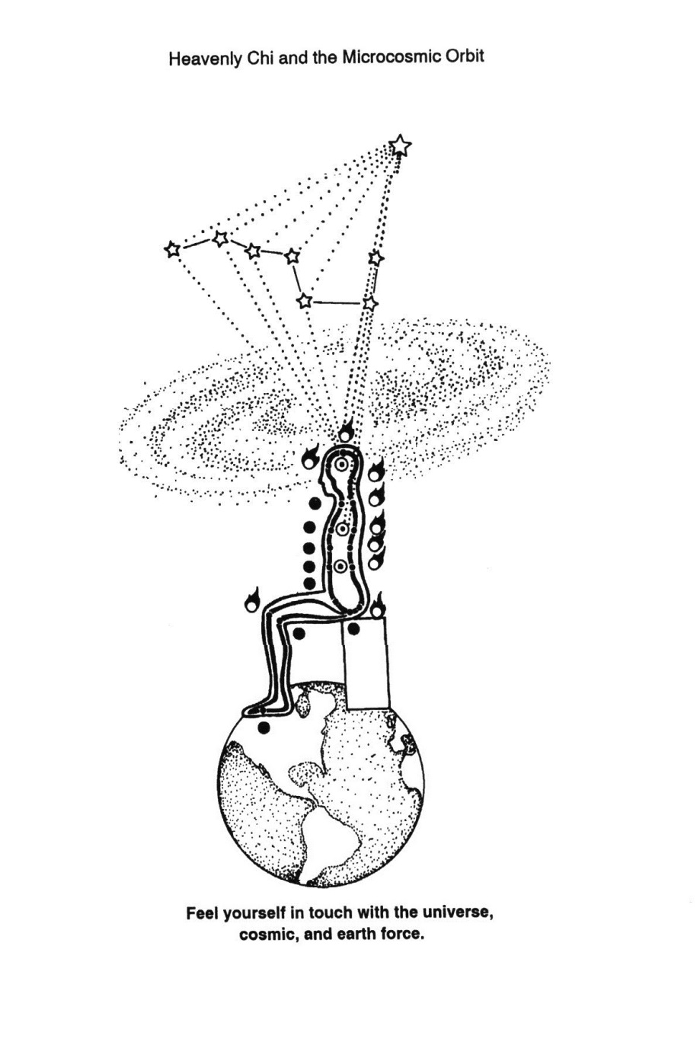
Macrocosmic Orbit

Slide 11
Baguazhang 5 Phases & Orientations

Slide 12
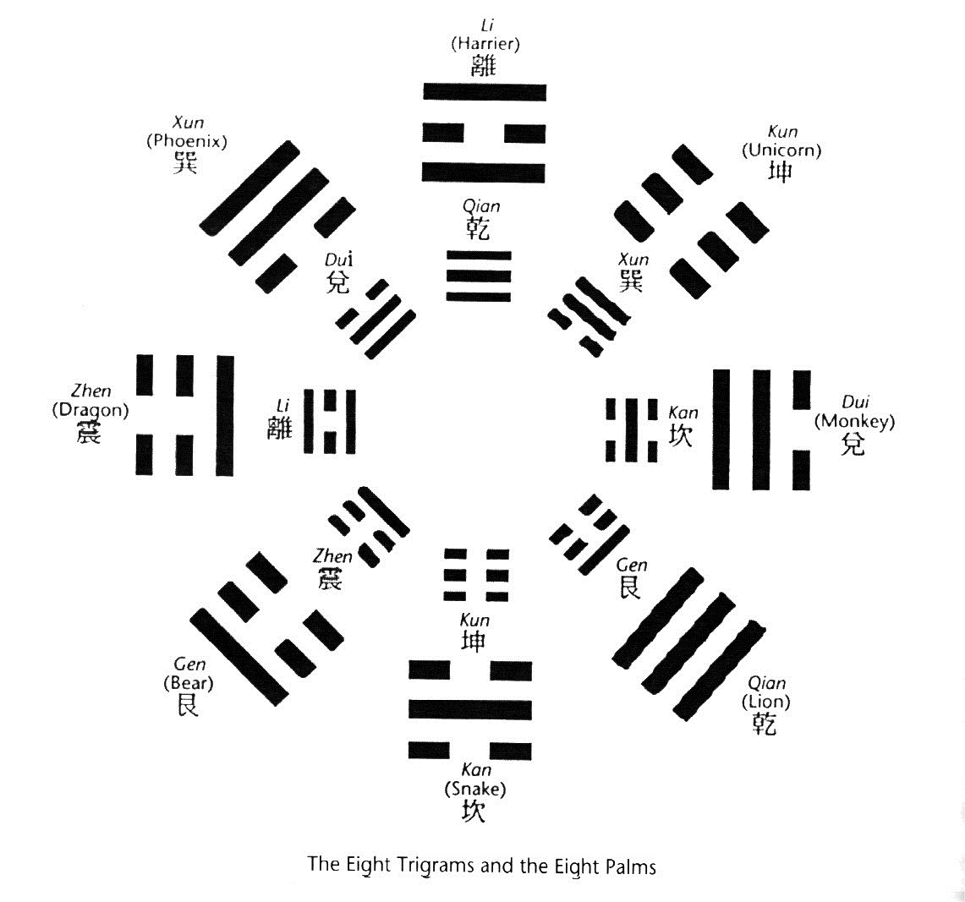
Baguazhang 8 Trigrams & 8 Palms

Slide 13
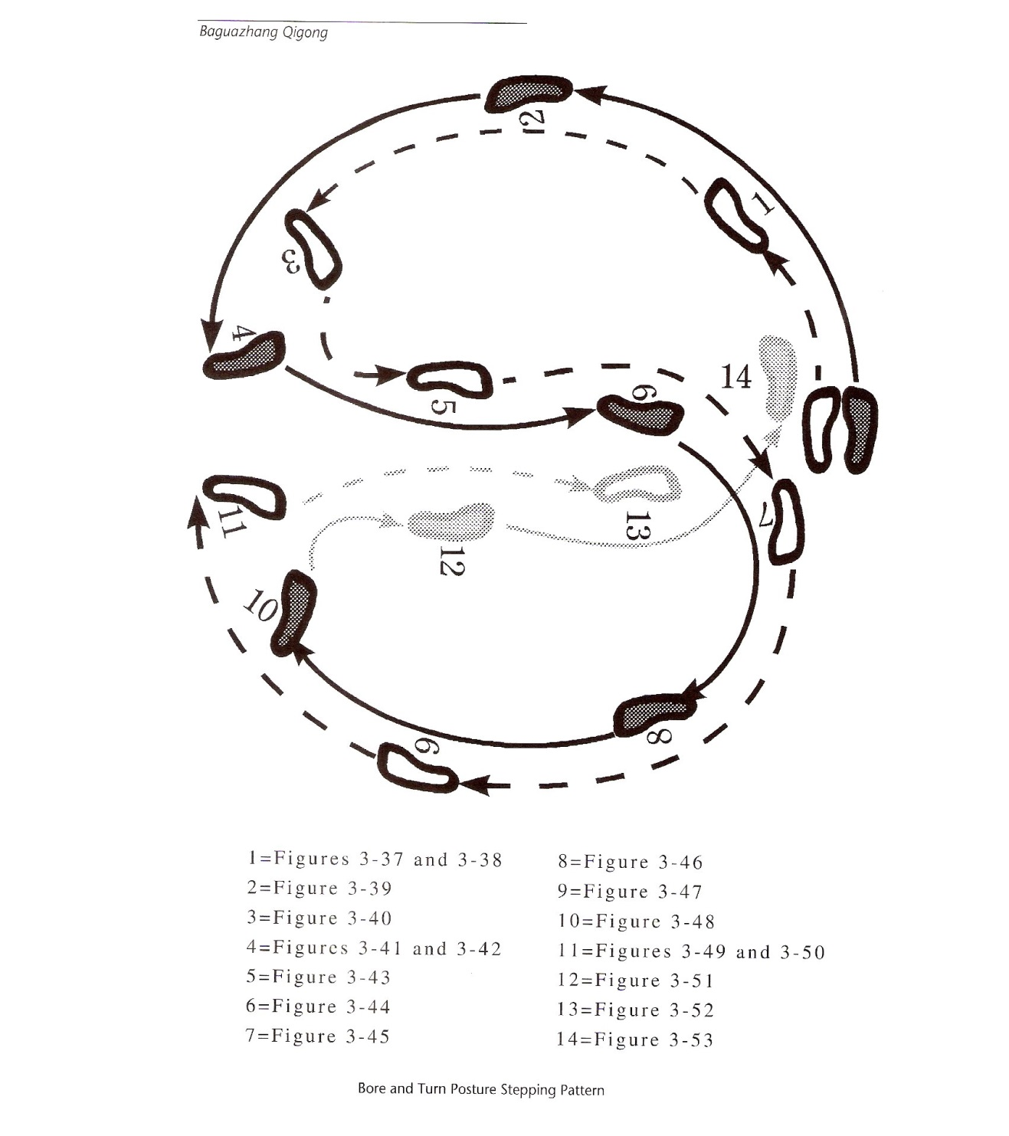
Baguazhang Stepping Pattern

